Slide 1
Neural Style Transfer of Paintings to Portraits and Selfies
CS 464 – Final Presentation
Group 7

Slide 2

MOTIVATION
Selfie editing applications are quite popular.
Latest applications utilize AI-based technologies.

Slide 3
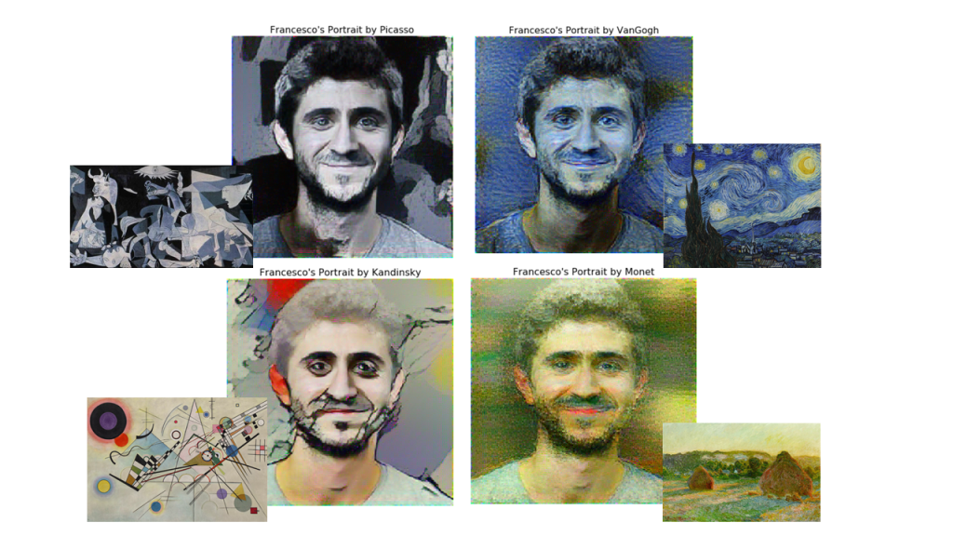
PARTICULAR FOCUS
NST of classical paintings to portraits and selfies

Slide 4
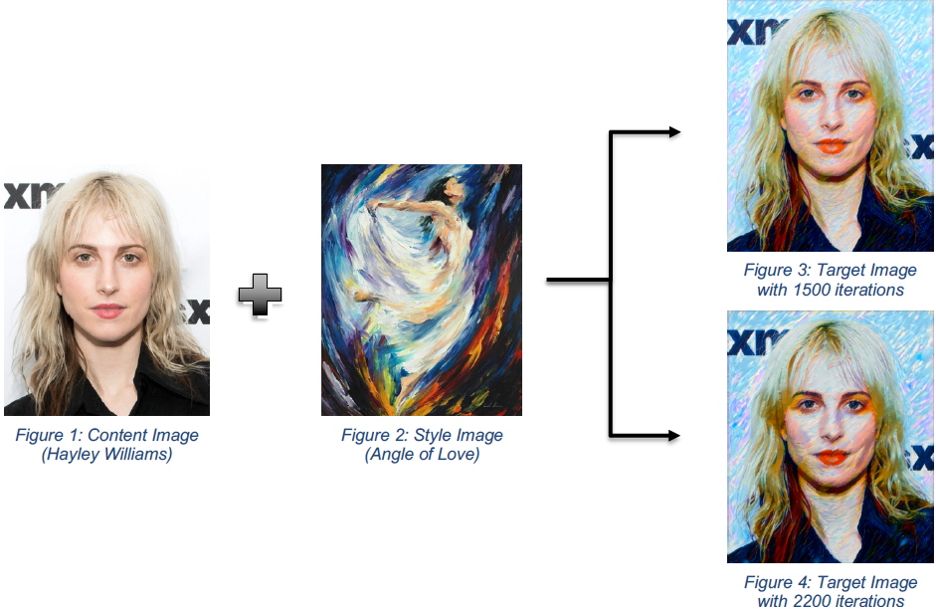
NEURAL STYLE TRANSFER
Blending the style and content of two images

Slide 5
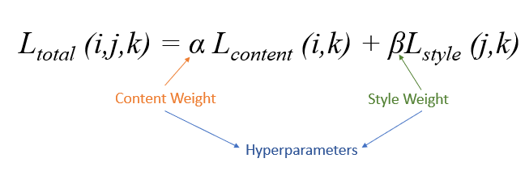
BACKGROUND RESEARCH
The optimizer optimizes the weighted sum of style and content losses.
Notes:
Here, the weights are hyperparameters (they can be customized).

Slide 6
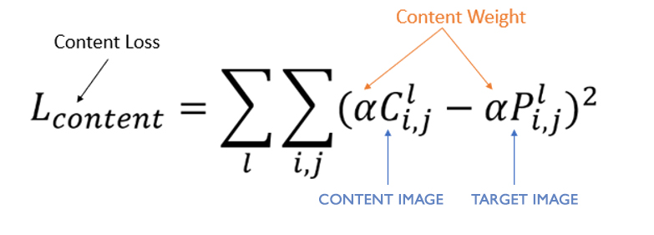
BACKGROUND RESEARCH
The content loss function is defined as the squared difference of the content and target images.
Notes:
Here, the weights are hyperparameters (they can be customized).

Slide 7
BACKGROUND RESEARCH
The style loss function is the squared difference between the gram matrices of the style and target images.
Gram matrices are computed multiplying style and target tensors by their transposes.
Notes:
Here, the weights are hyperparameters (they can be customized).

Slide 8
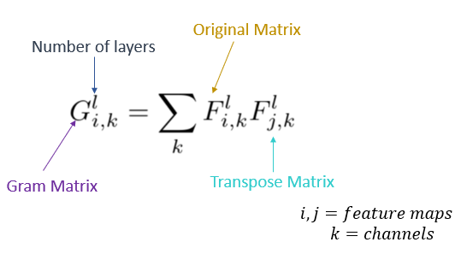
BACKGROUND RESEARCH
The computation of the Gram matrices

Slide 9
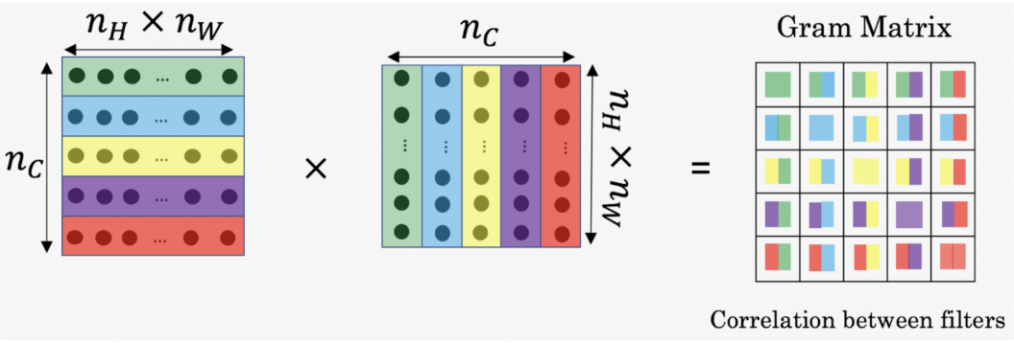
BACKGROUND RESEARCH

Slide 10
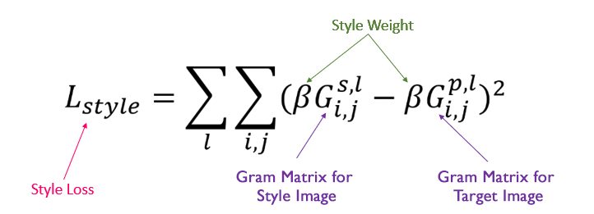
BACKGROUND RESEARCH
Style loss function defined with the gram matrices: (Style – Target)²
Notes:
Here, the weights are hyperparameters (they can be customized).

Slide 11
WHAT IS DONE
VGG-19 pre-trained model was used.
Gram matrices of the style and target were computed.
Parameters of the target image were optimized with Adam.

Slide 12
WHAT IS RECENTLY DONE
Several bugs in image and video rendering is fixed.
The quality of the target image is enhanced by experimenting with the hyper-parameters.
Users can now specify an artist instead of providing the style image.
Style transitions can now be saved as a video.

Slide 13
EXPERIMENTS
Different weights are given to the content and style losses.
The learning rate and number of layers are changed.
Various pre-trained models are considered.
Notes:
The most successful pre-trained model was VGG-19.

Slide 14
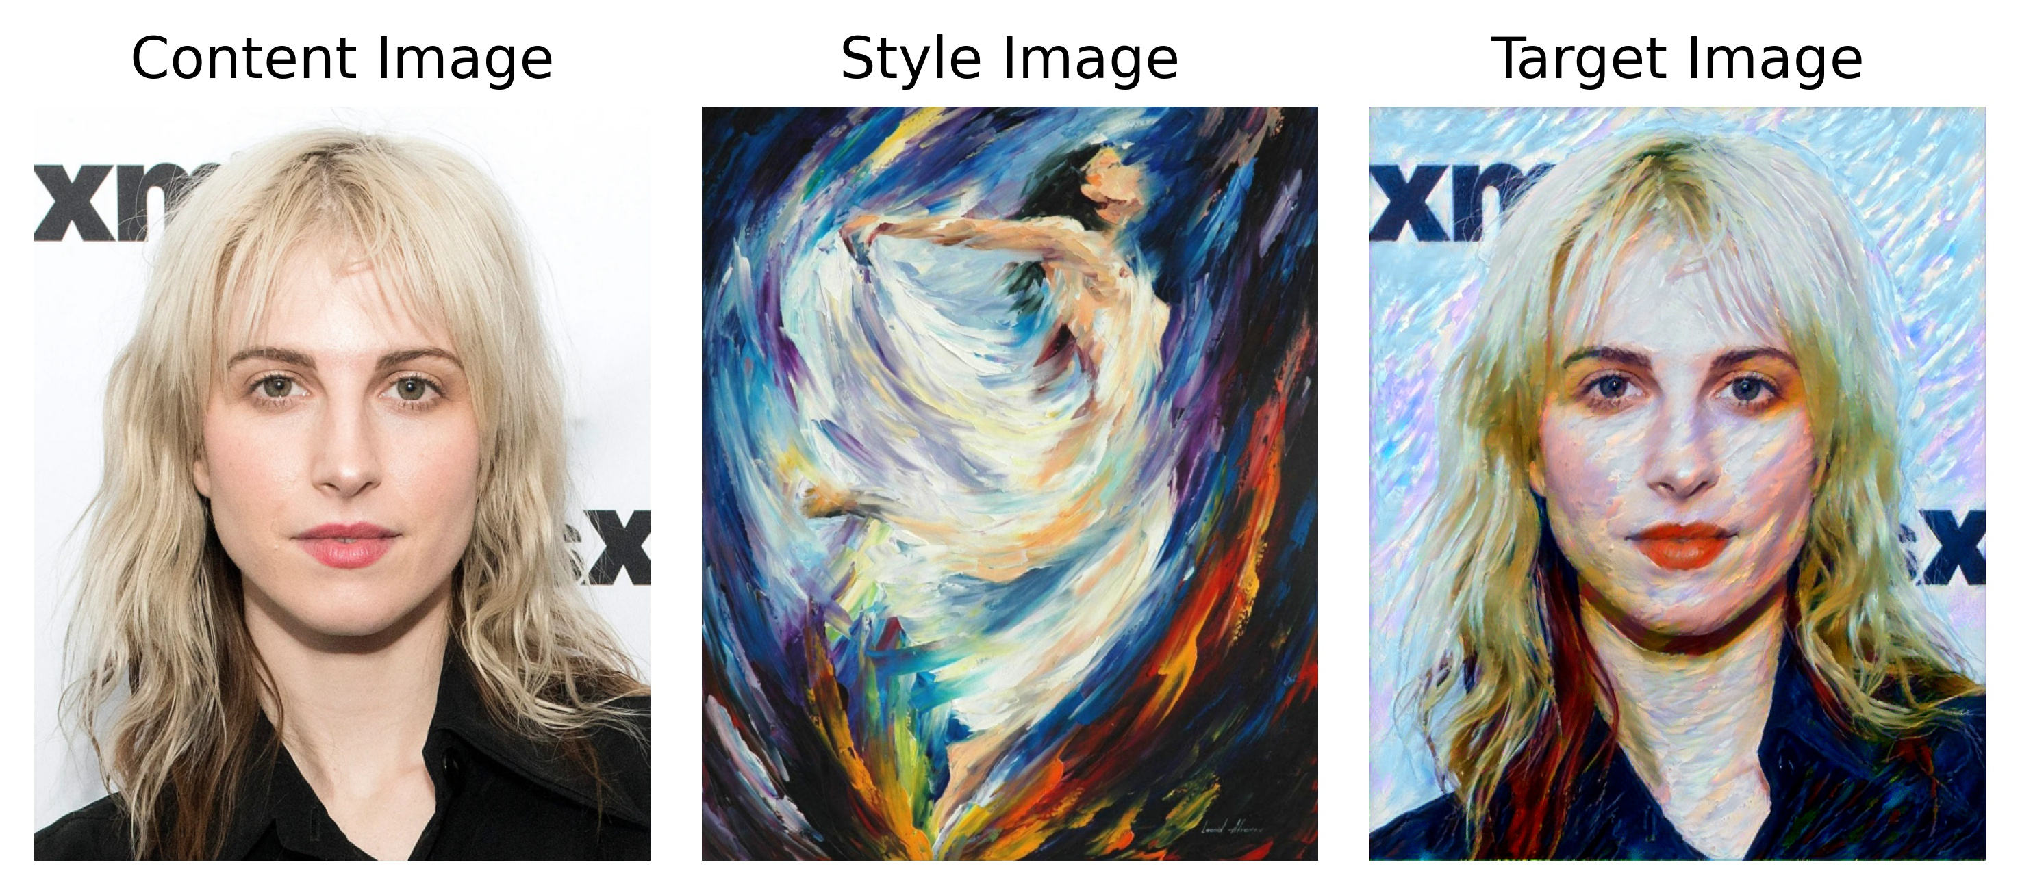
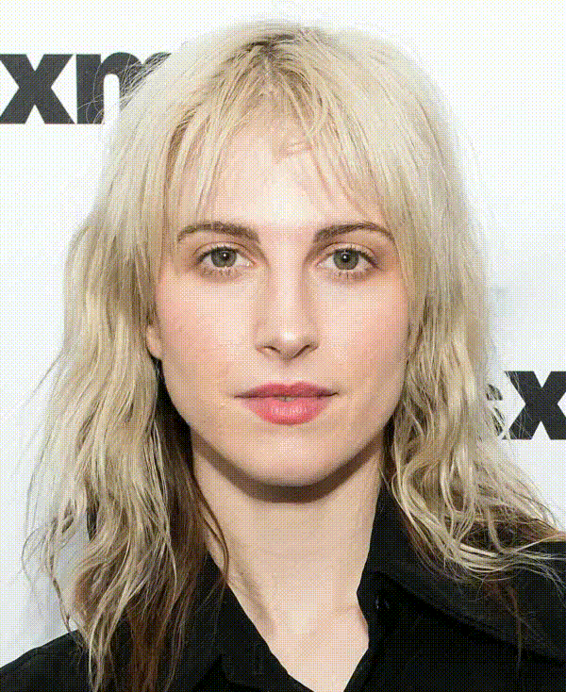
THE END PRODUCT

Slide 15
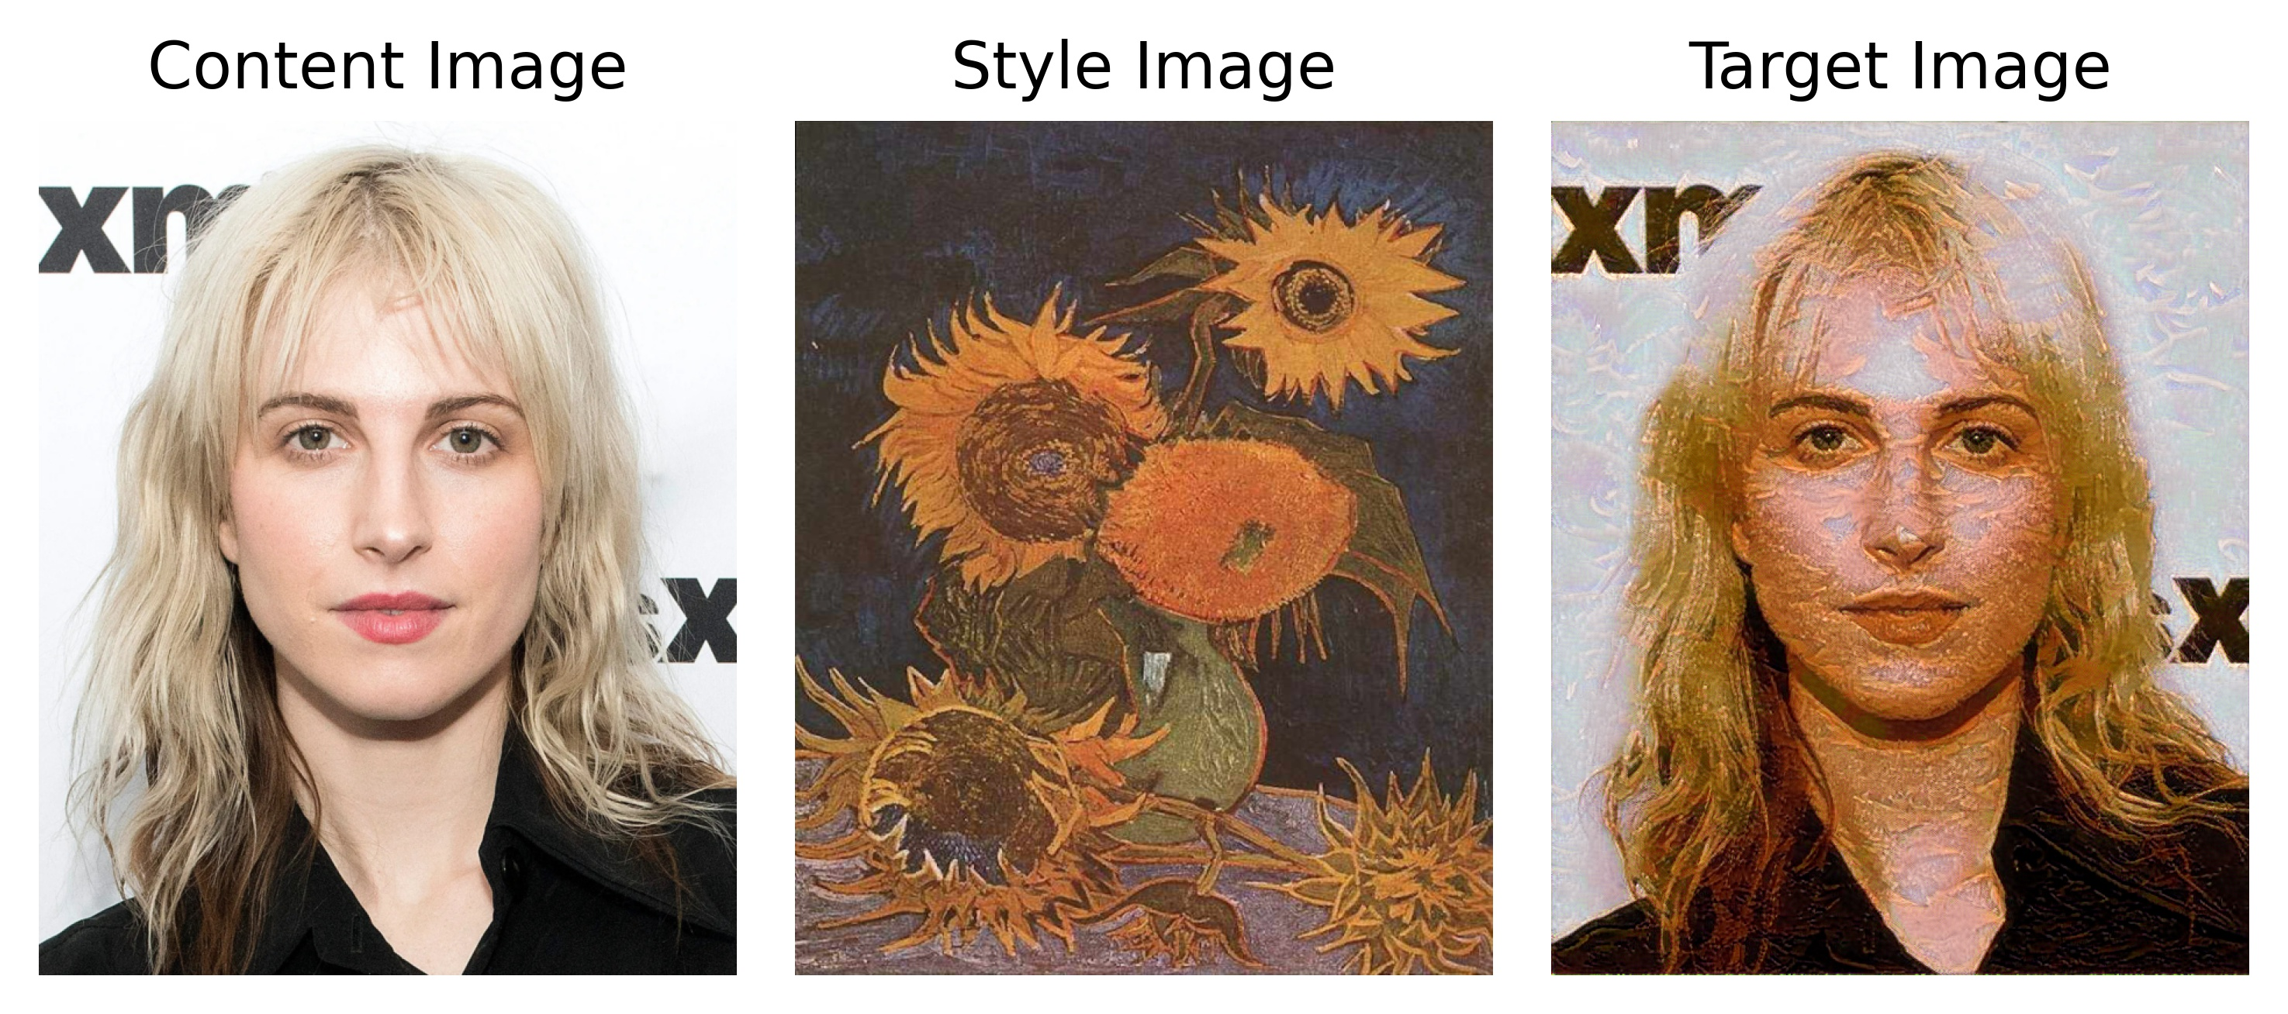
THE END PRODUCT

Slide 16
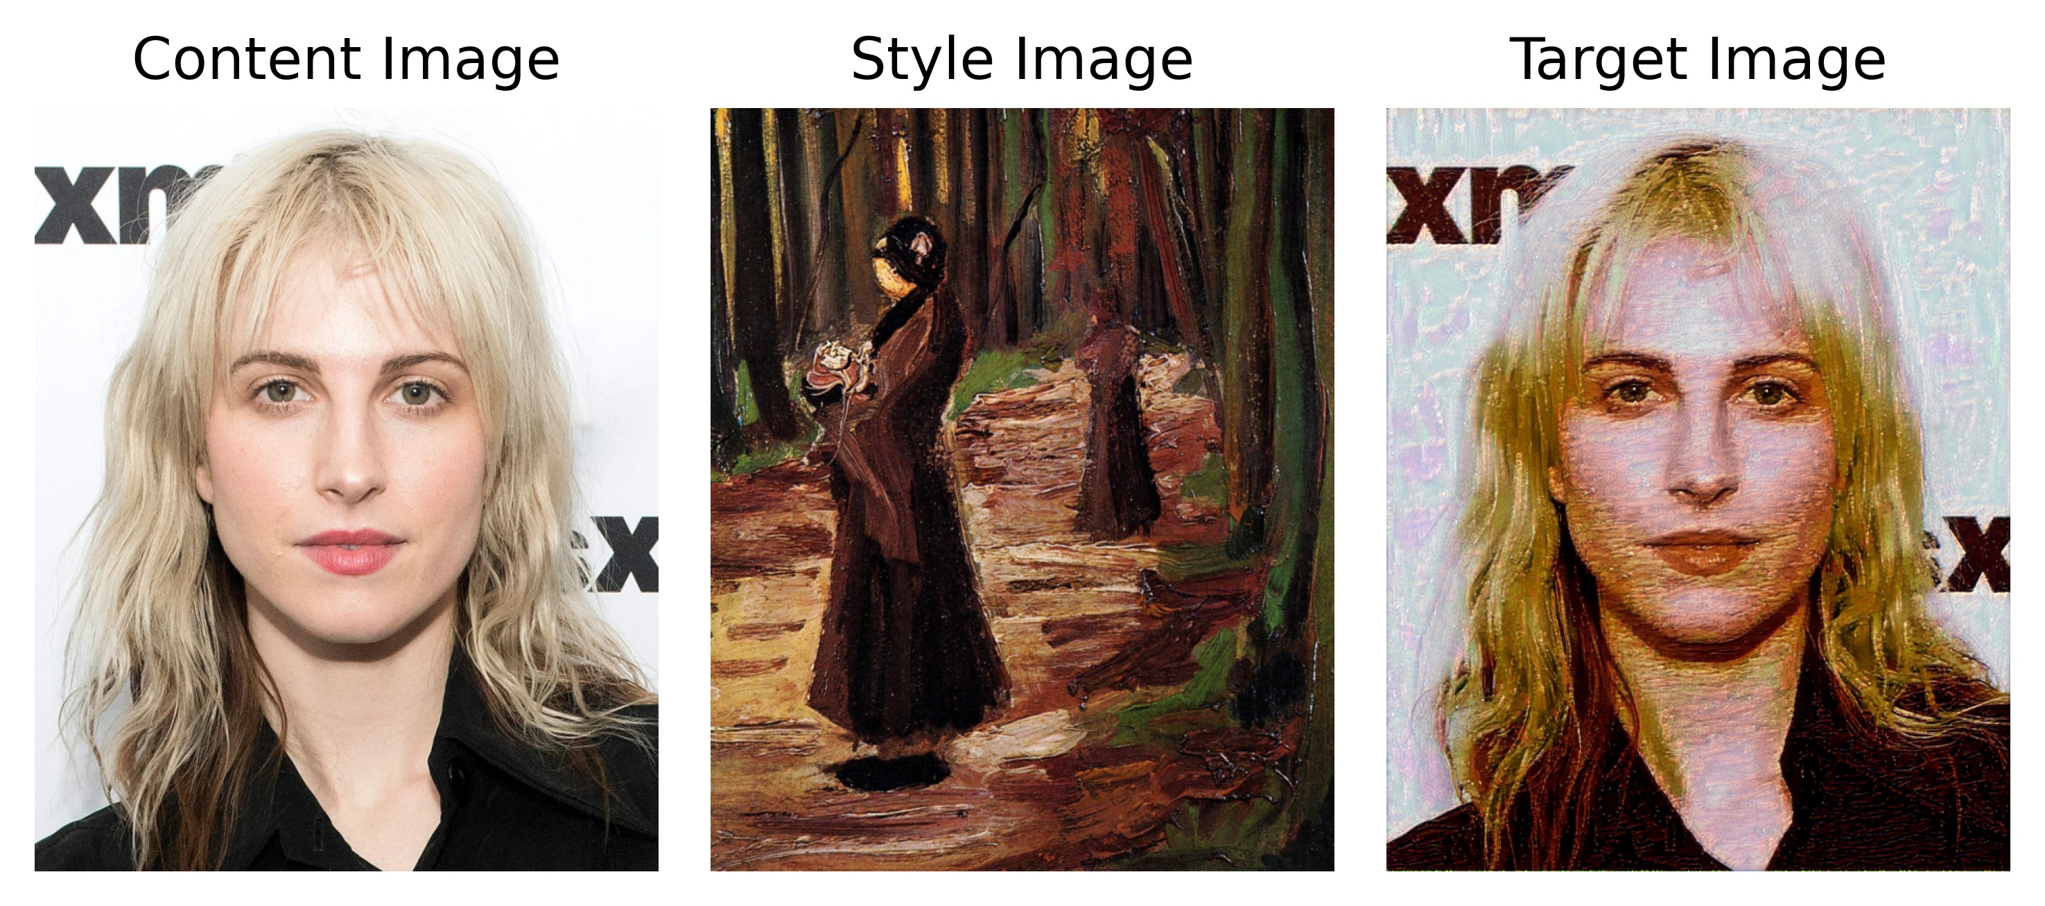
THE END PRODUCT

Slide 17
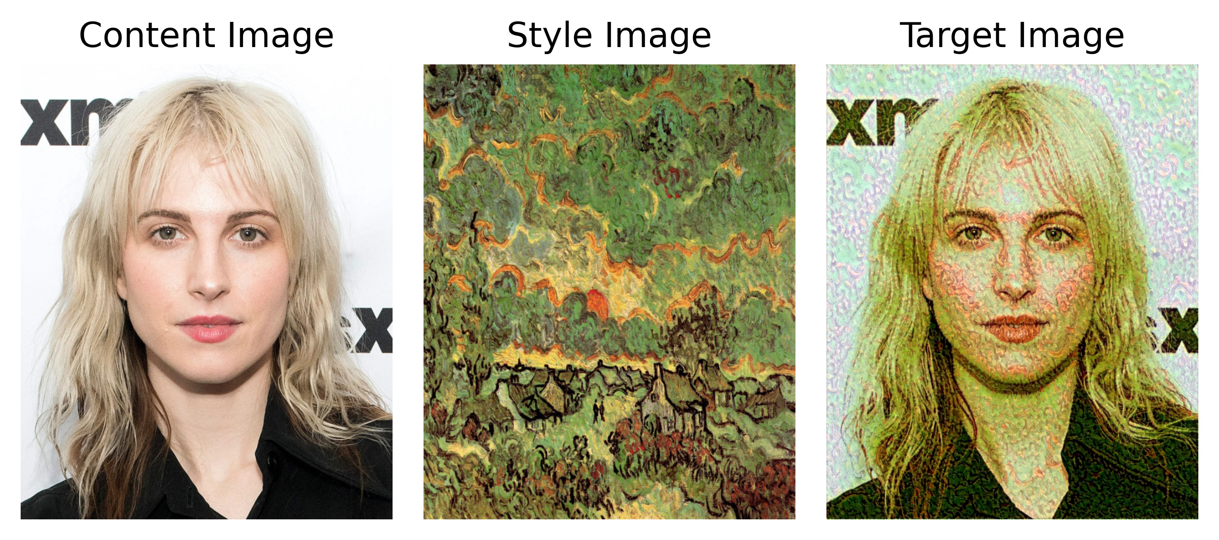
THE END PRODUCT

Slide 18
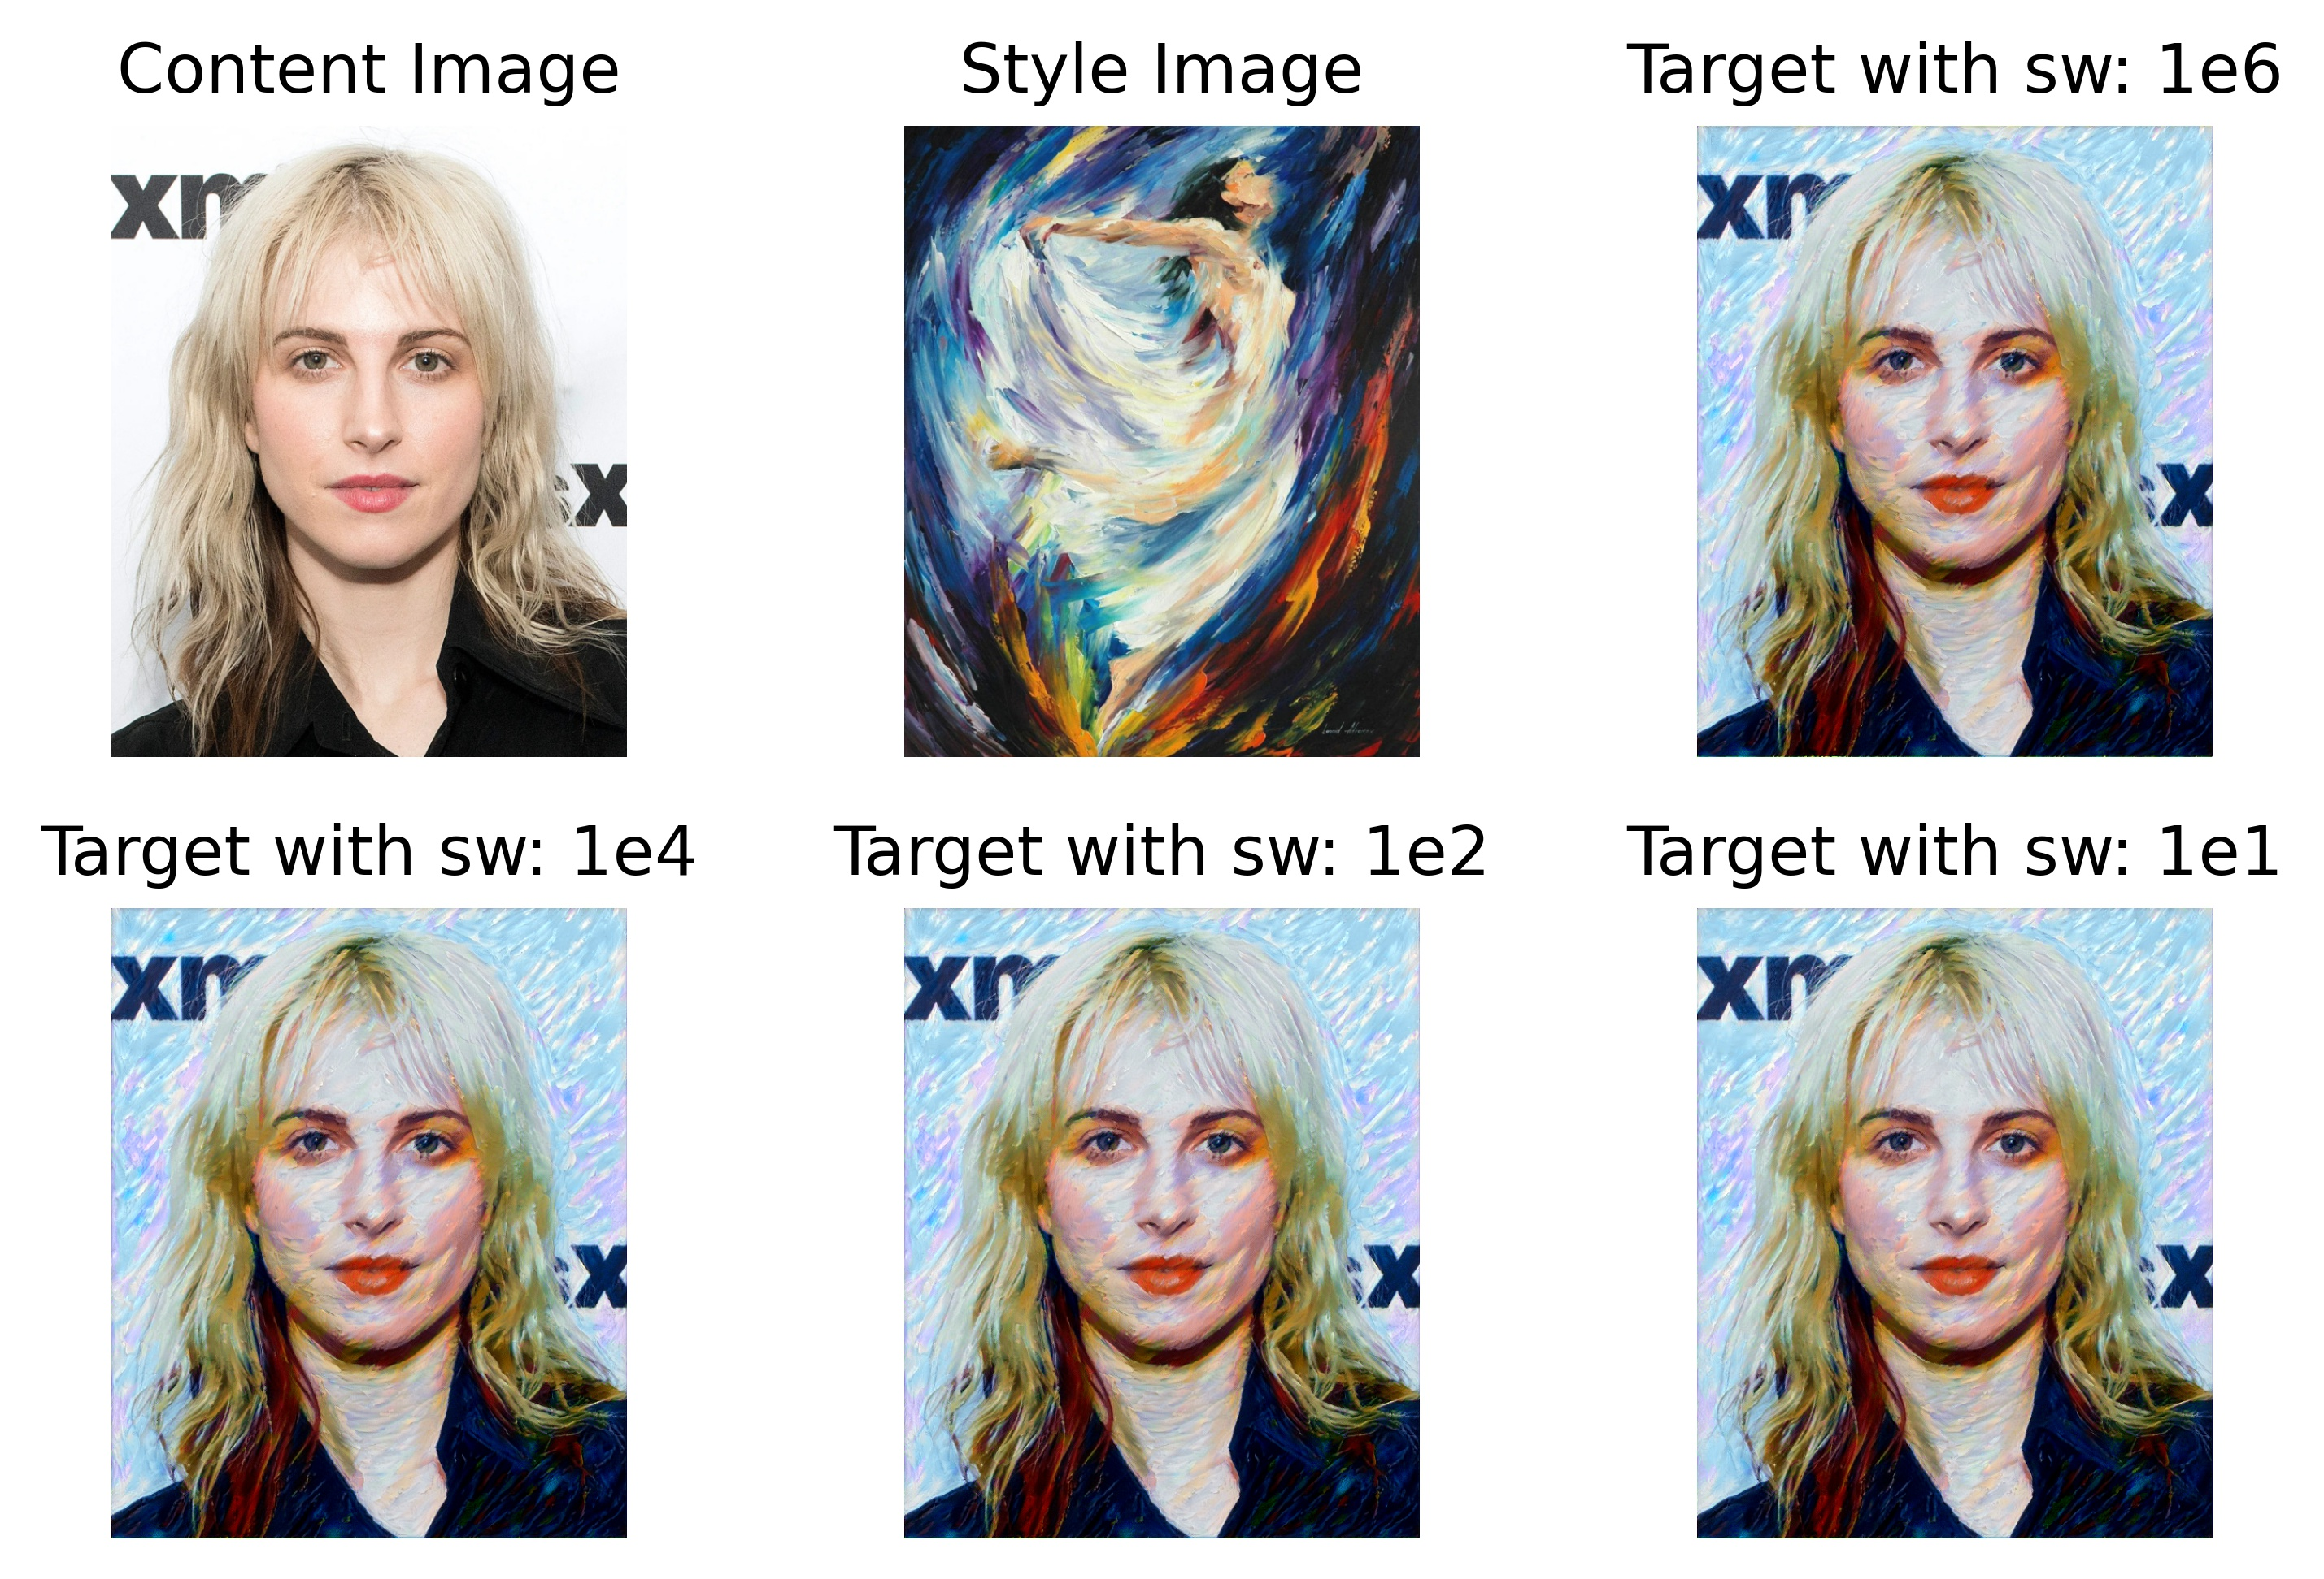
ALPHA RATIO EXPERIMENT

Slide 19
Learnıng rate EXPERIMENT
Will be stated in the final report.

Slide 20
CONCLUSION
The algorithm we used is essentially an optimization algorithm.
There is no training process; model parameters change for each content & style pair.
Consequently, what we do is an image processing task.
Notes:
This is why this algorithm is not practical for a mobile application.

Slide 21
DEMO AND VIDEO
Notes:
This is why this algorithm is not practical for a mobile application.

Slide 22
THANK YOU

